Slide 1
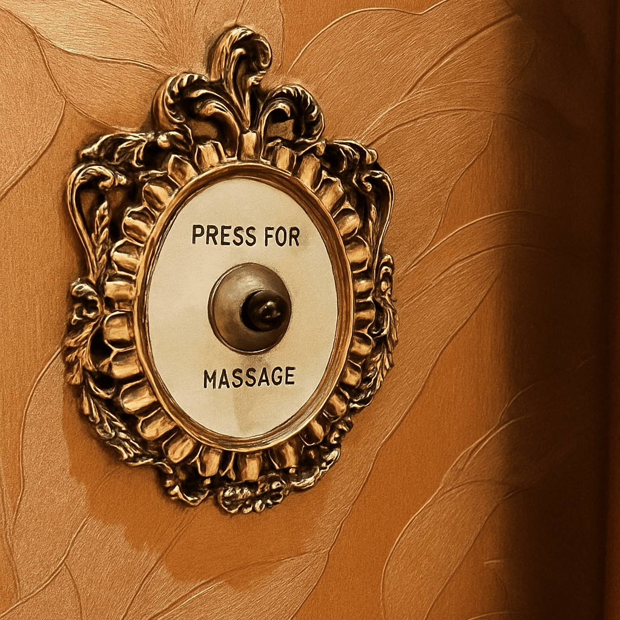
Veyya
Veda वेद 🤝🏼 sahāya सहाय
From the Sanskrit words Veda (knowledge) and Sayāya (companion, helper or ally) we introduce you to
Veyya.
Your trusted expert.
Your confidant.
Your ally.
Premium services for your busy lifestyle, all from the comfort of your home.

Slide 2
Veyya
Veda वेद 🤝🏼 sahāya सहाय
From the Sanskrit words Veda (knowledge) and Sayāya (companion, helper or ally)
We introduce you to Veyya.
Your trusted expert.
Your confidant.
Your ally.
Premium services for your busy lifestyle, all from the comfort of your home.

Slide 3
Veyya represents "on demand Living" — combining luxury comfort, simplicity, and trust within the home. It should feel warm, elegant, and modern, while standing out as aspirational yet accessible.
Brand Personality
Trait | Expression
Cozy | Soft, warm tones; gentle textures
Luxury | Subtle metallics (champagne, gold, taupe); minimal aesthetic
Home | Natural materials, earthy bases (stone, beige, warm neutrals)
Simple | Clean layouts; whitespace; intuitive design
Buzz-worthy | Modern contrast element or pop color; sleek iconography; visual storytelling that photographs beautifully

Slide 4
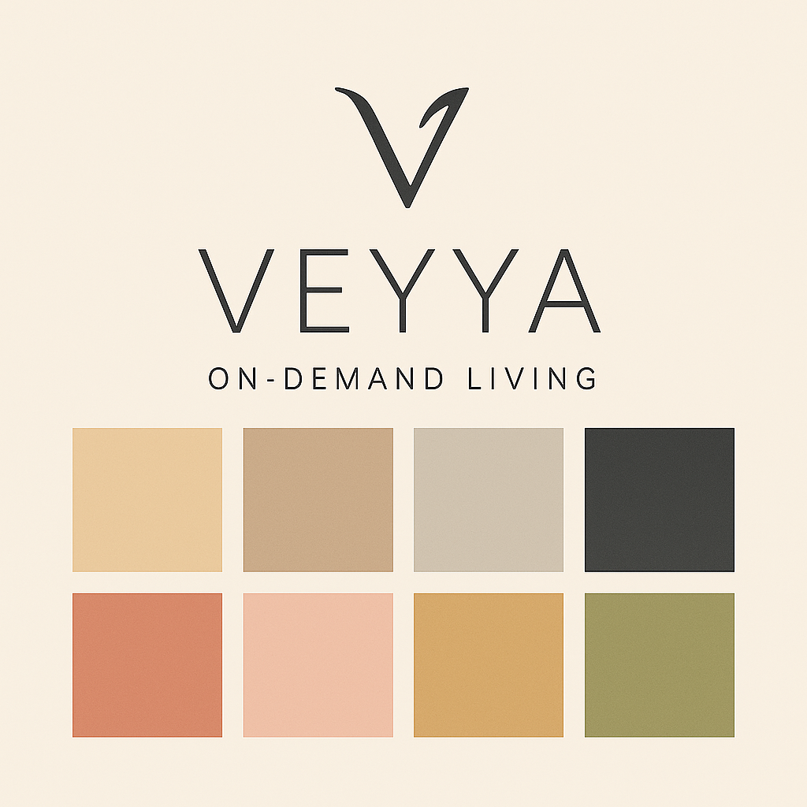

Slide 5
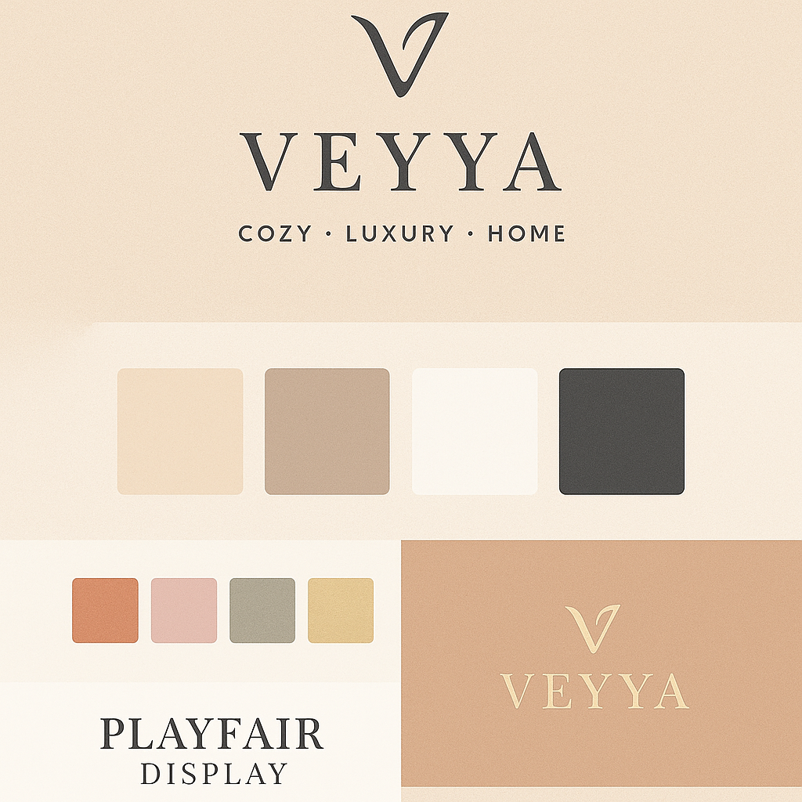
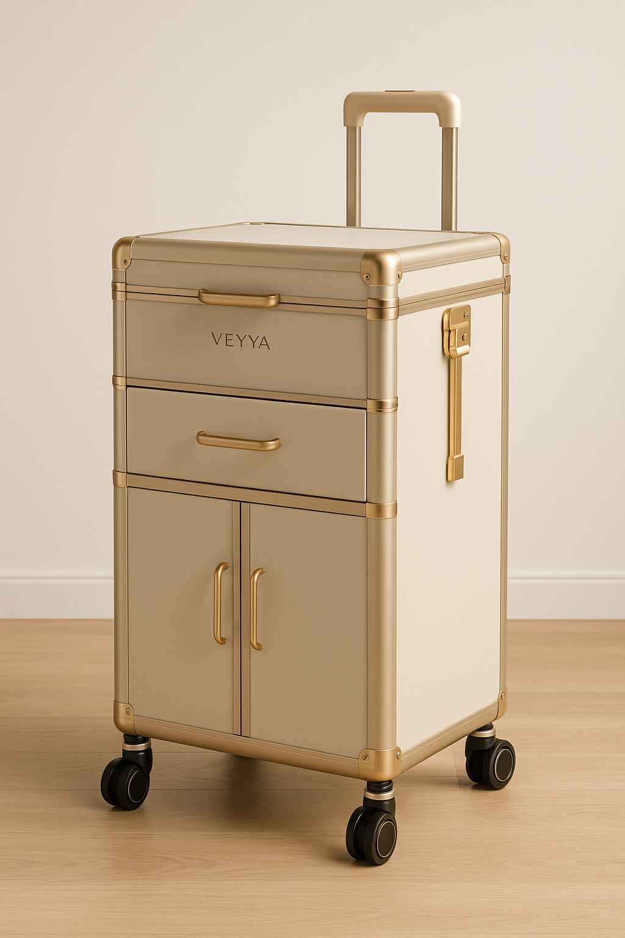

Slide 6
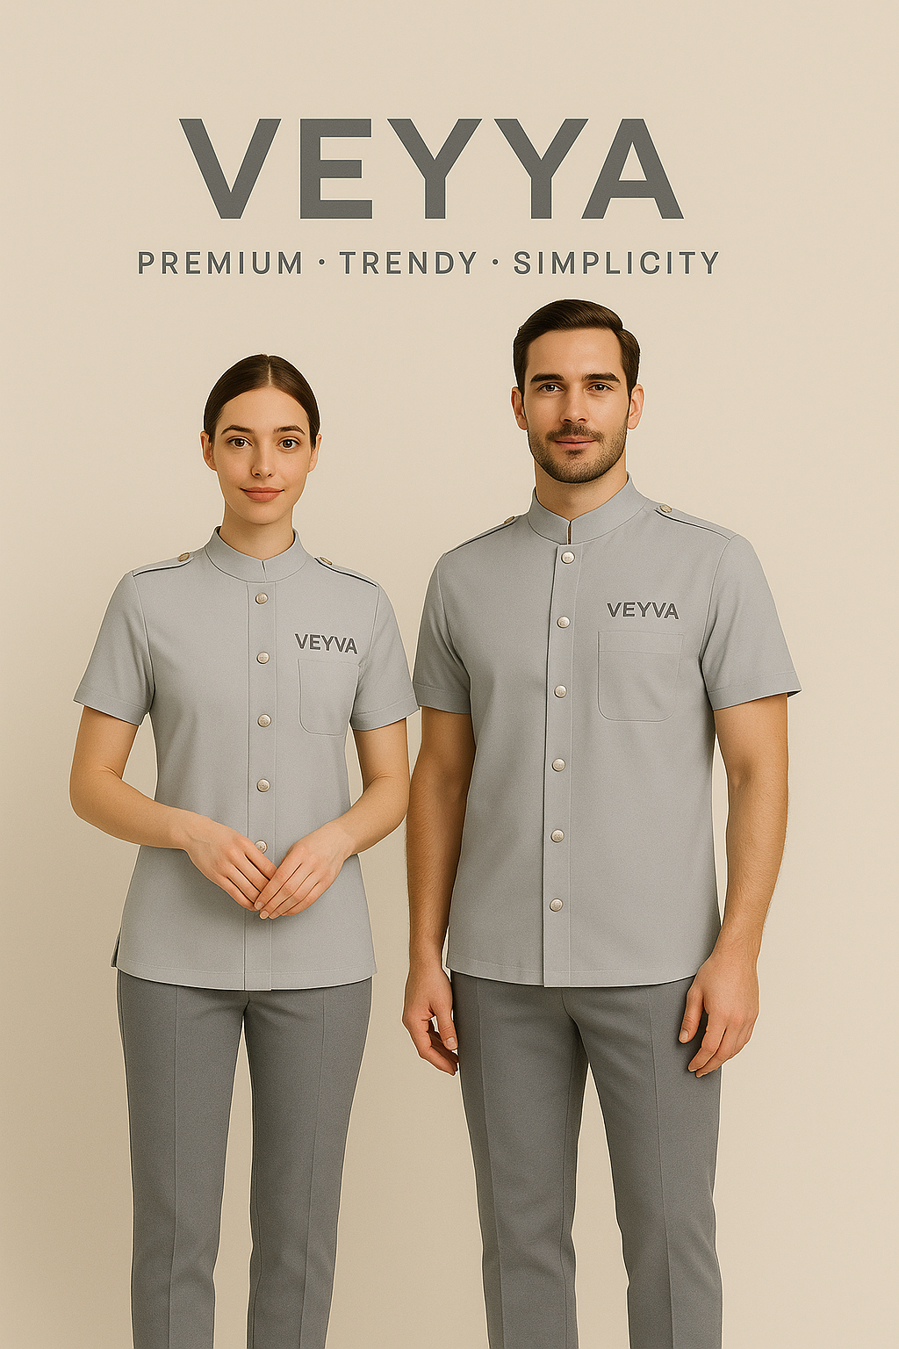
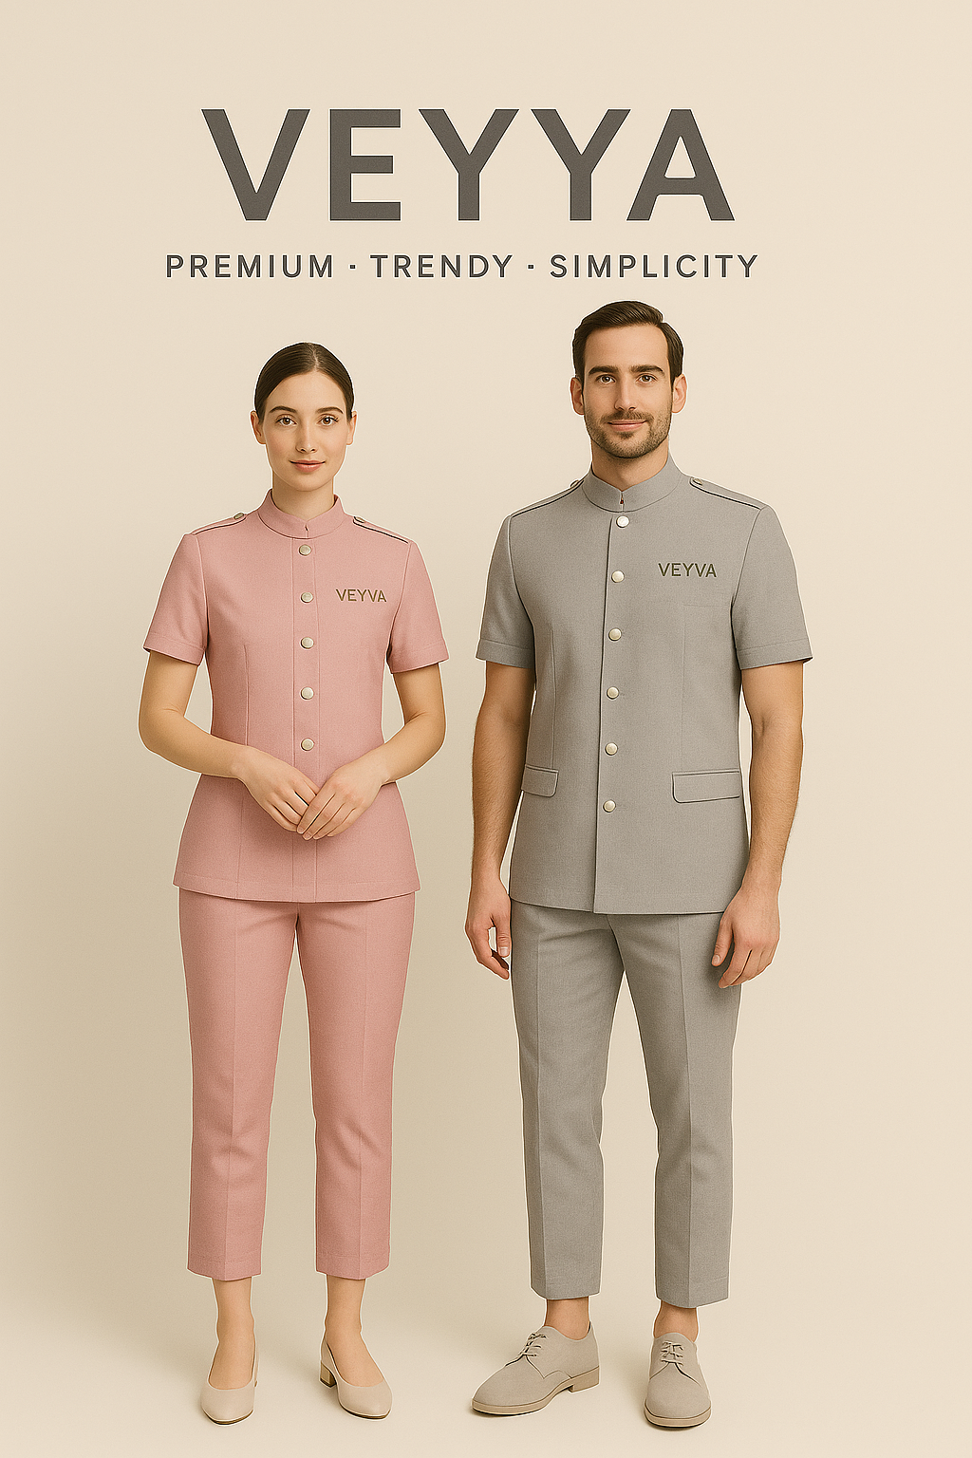

Slide 7

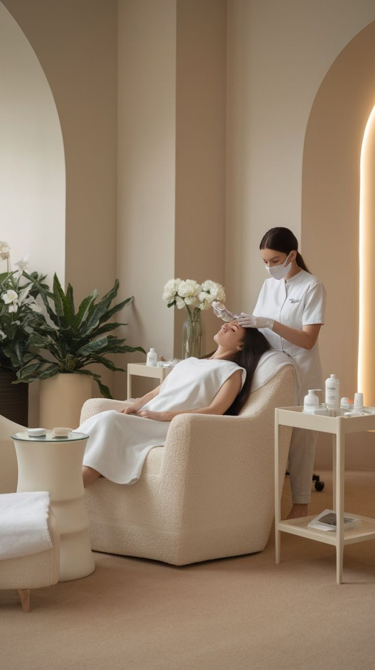
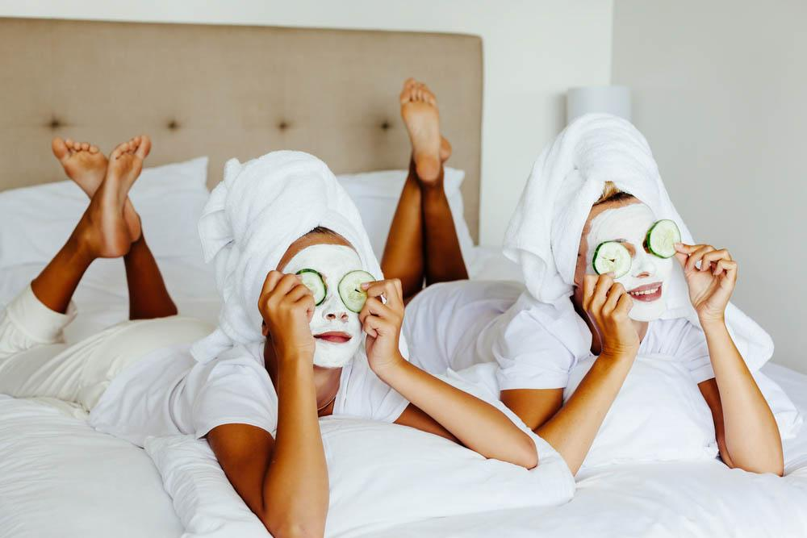
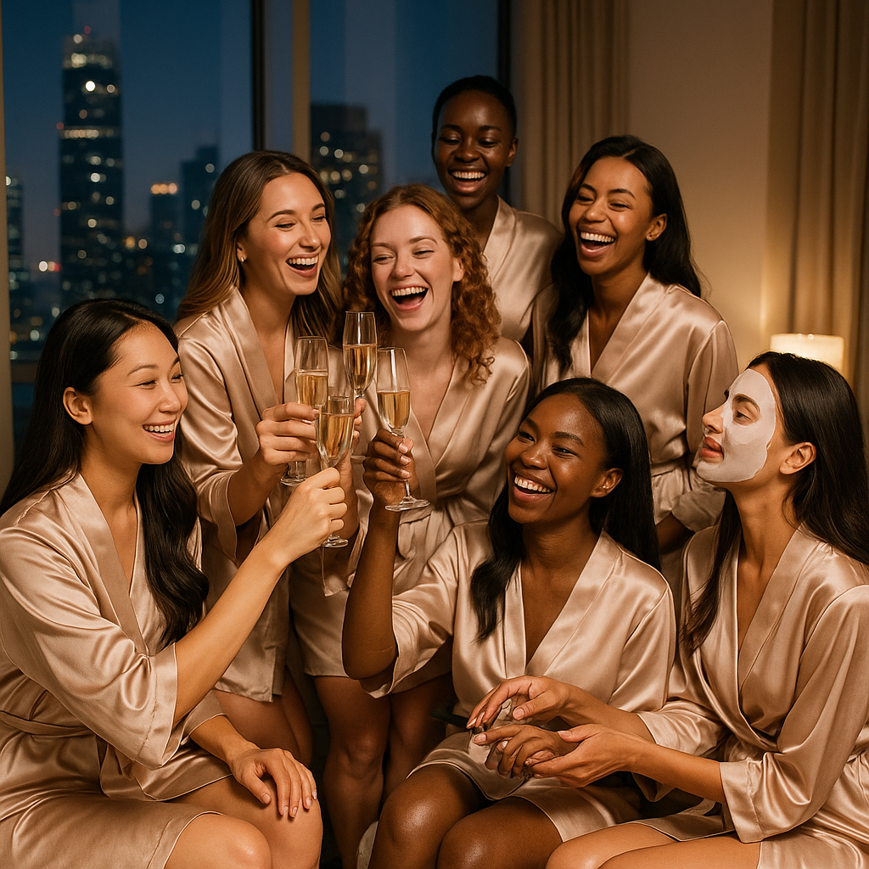
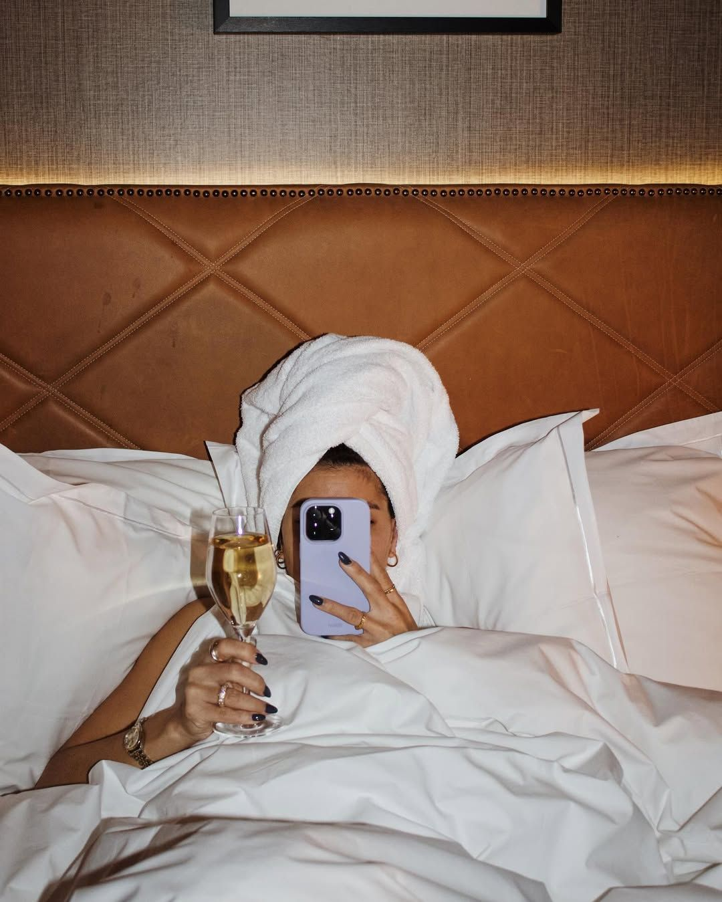
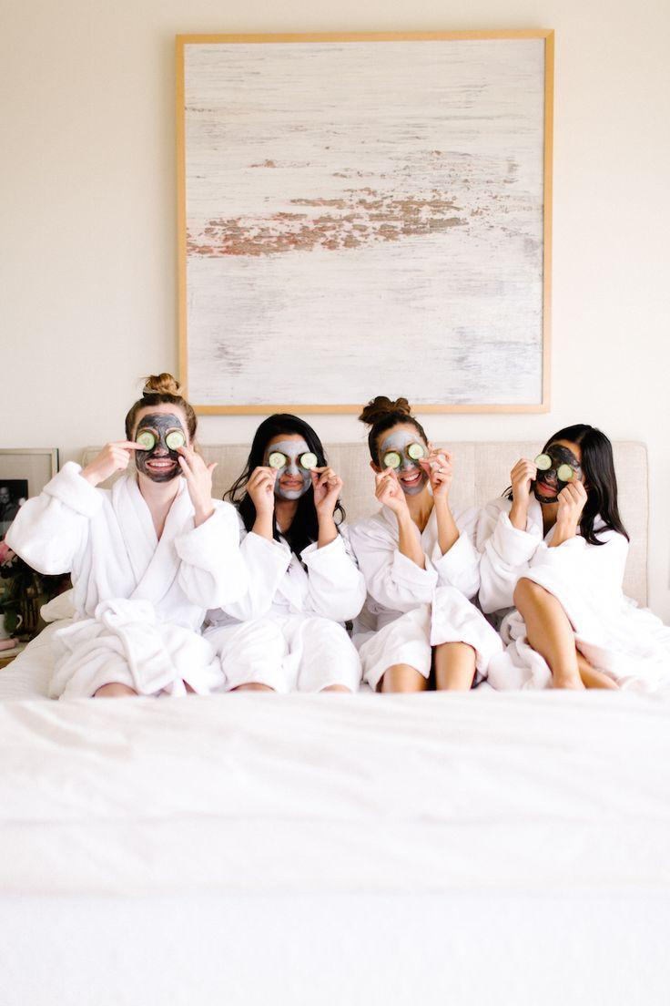

Slide 8
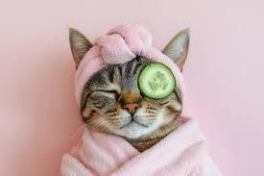

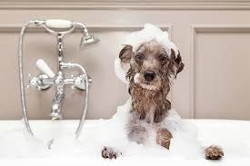

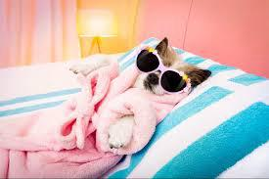

Slide 9
Luxury is….
Pamper sessions at home.
Sunday morning lie ins.

Slide 10
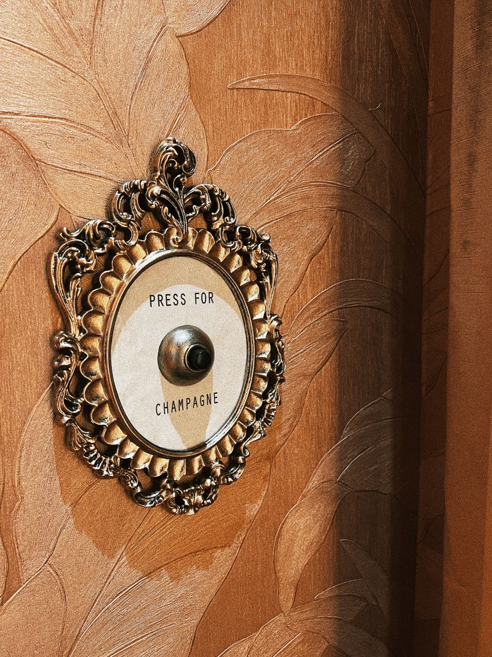
Luxury is….
Having anything you need at your fingertips

Slide 11
______
Veyya
That straight horizontal line running across the top of the letters in Sanskrit (and related scripts like Hindi’s Devanāgarī) is called the "śirorekhā" (शिरोरेखा) — literally meaning “headline” or “headstroke.”

Slide 12

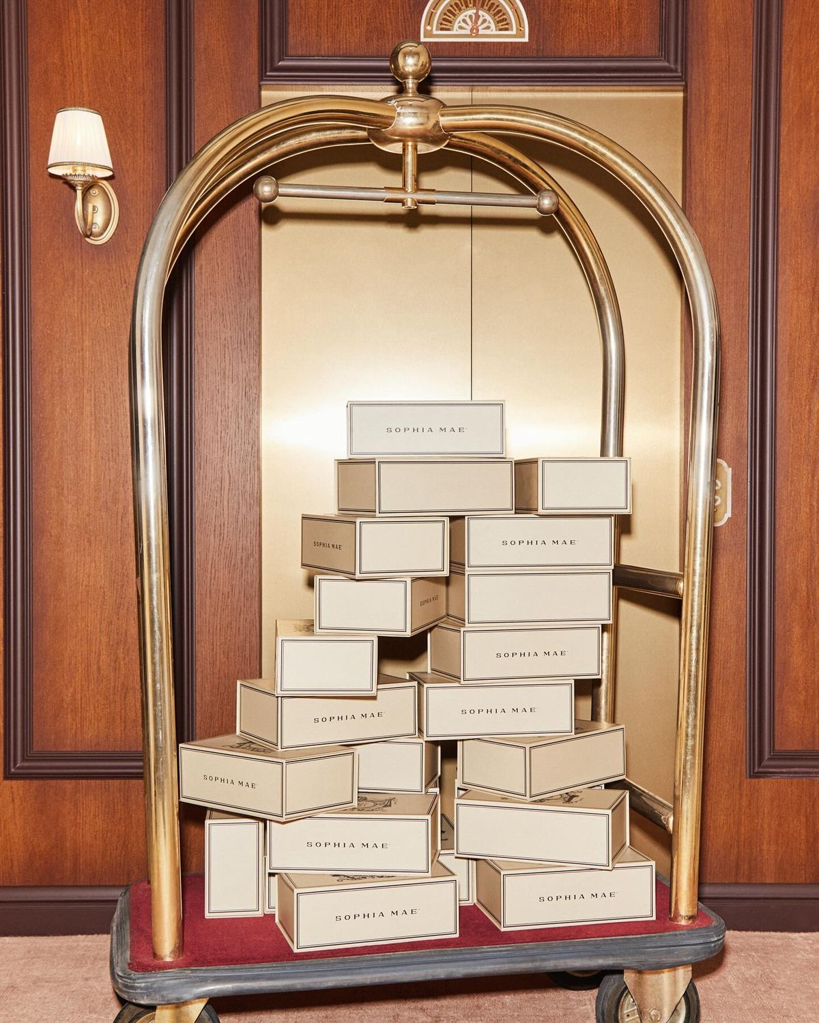
For those who…
Live a busy life
Know that time is a luxury

Slide 13
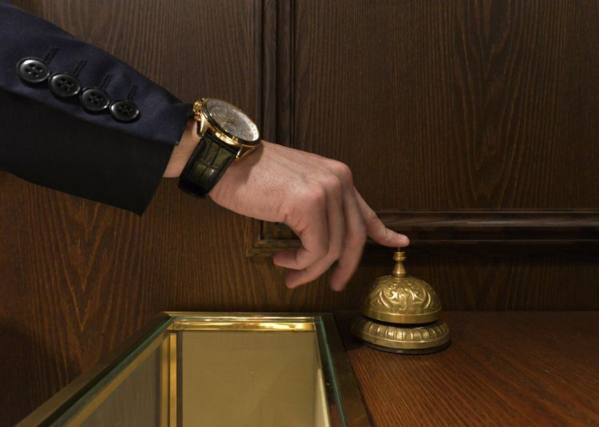

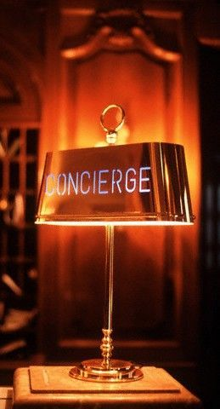
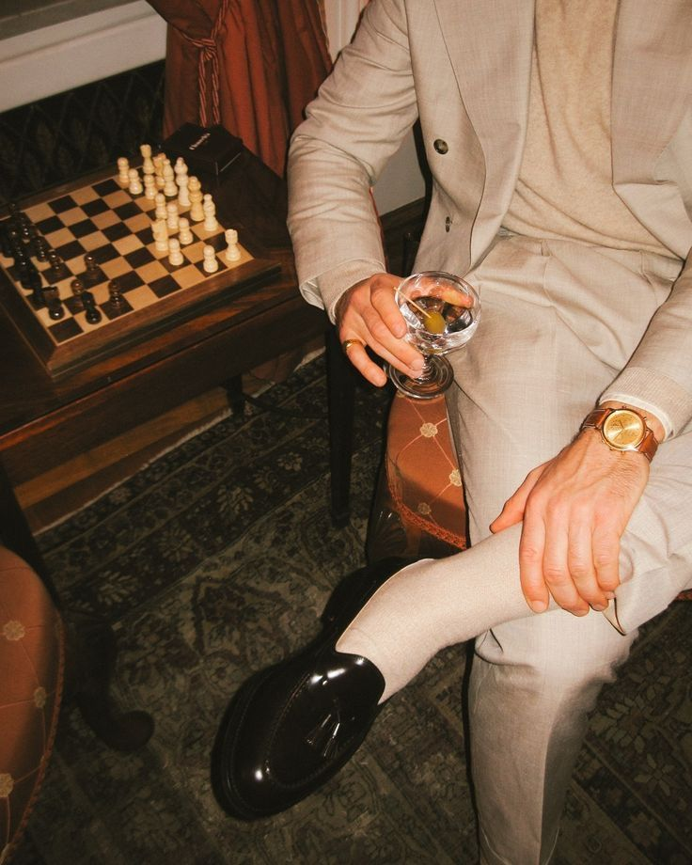
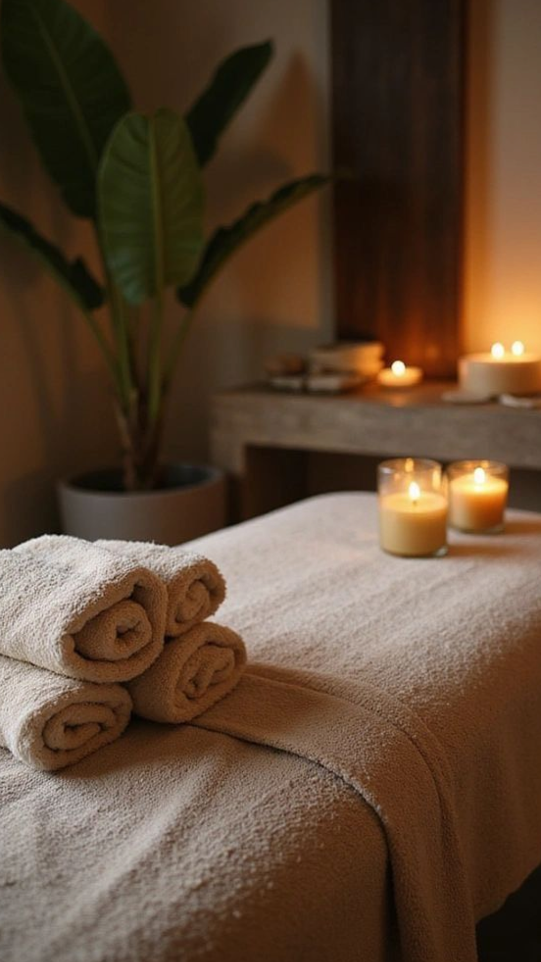
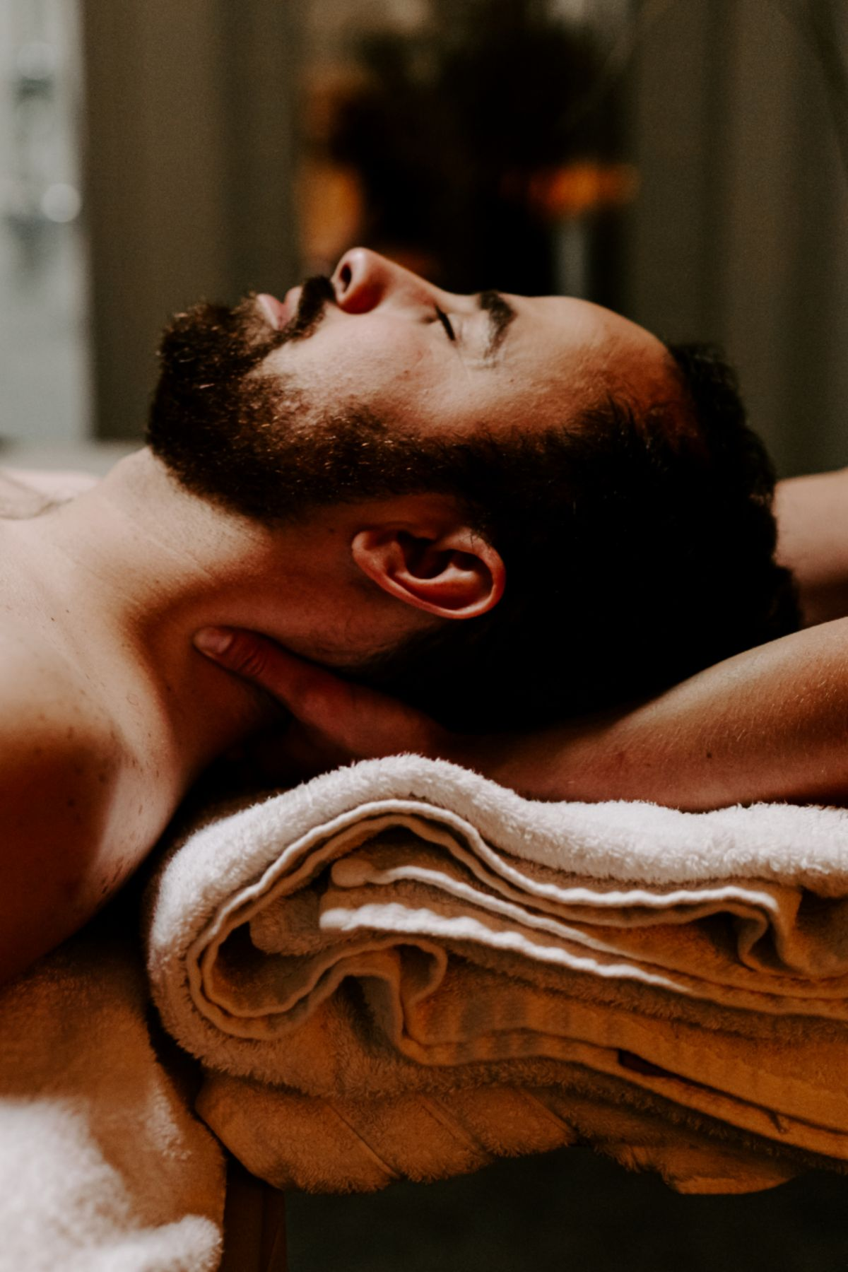
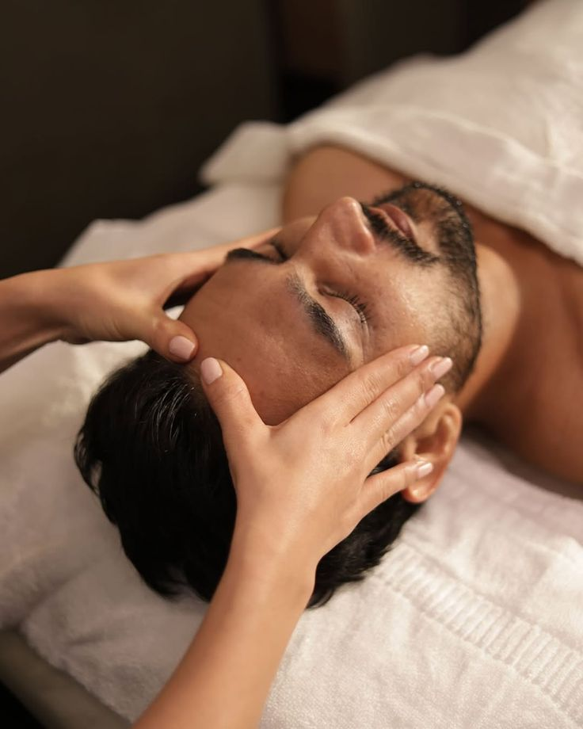
For those who…
Know what they want
And only trust the best

Slide 14
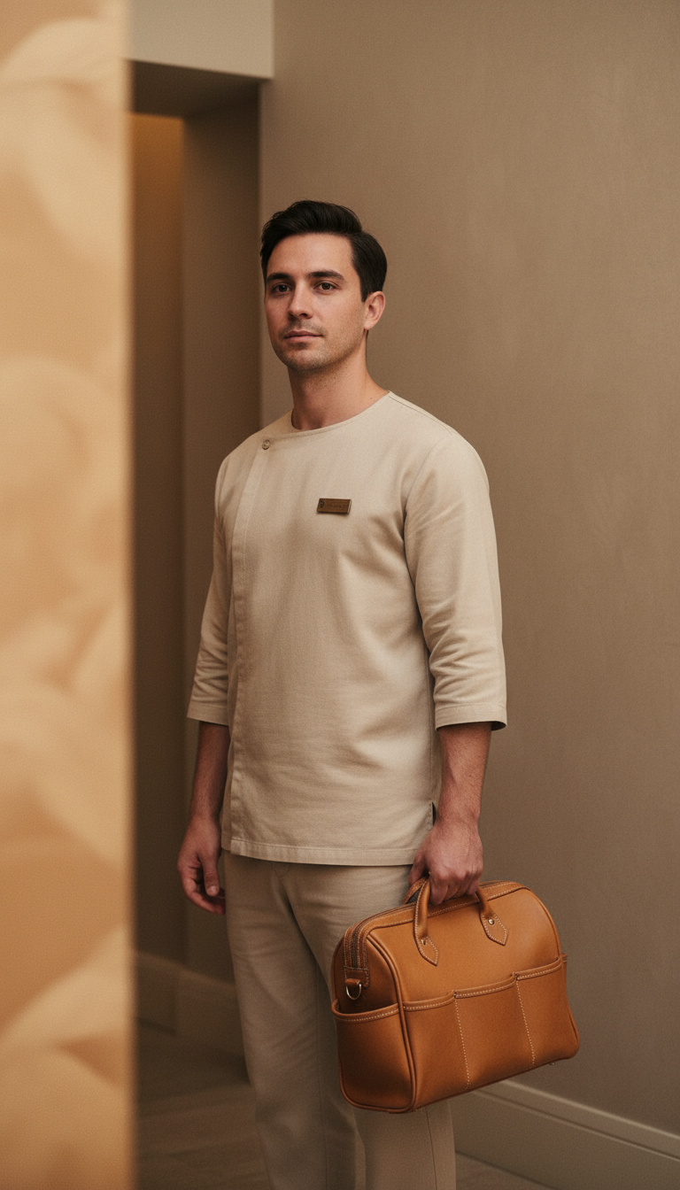
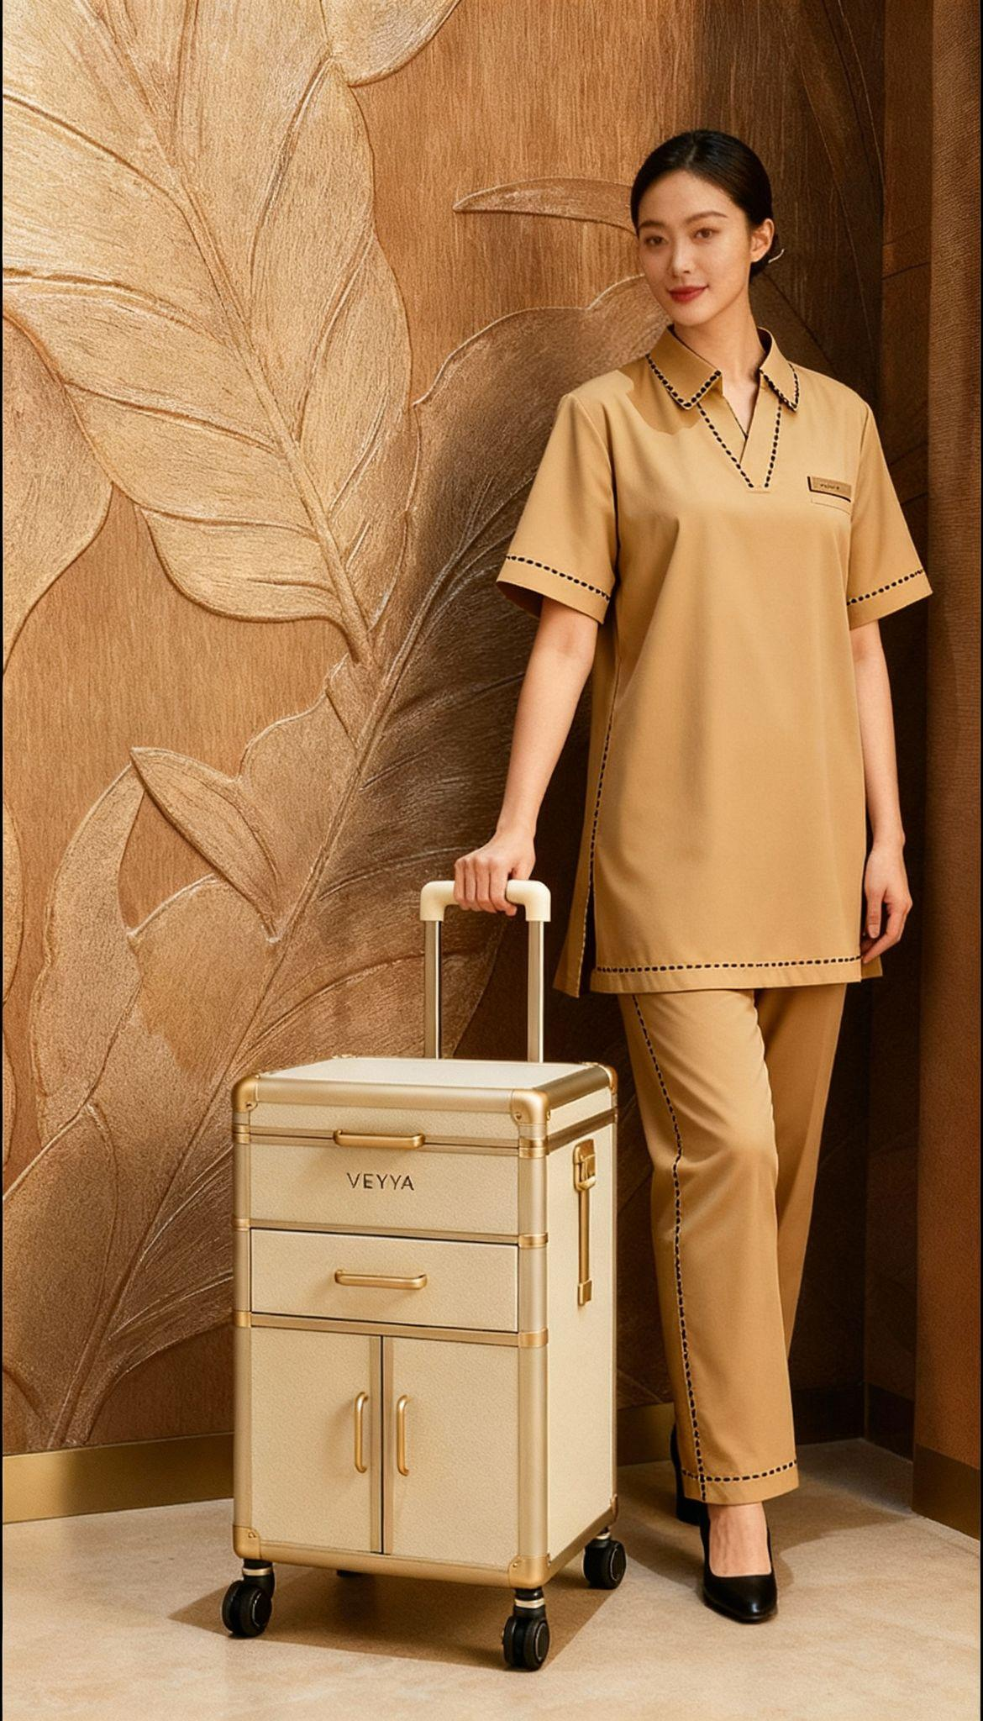
They trust
______
Veyya
Notes:
We’ll generate properly and update later

Slide 15
Business & User Problems
1. Fragmented Access and pricing for Everyday Services
2. Inconsistent Quality and Lack of Trust
The home services industry spanning beauty, cleaning, maintenance, and wellness is highly fragmented, offline with price variations, leaving consumers without a single trusted, convenient platform.
Customers struggle with unreliable service providers, unclear pricing, and no service standards eroding trust in an industry worth over $180B globally and growing 14% annually.
3. This is missing a title on the OG deck
4. Market demand for Simplicity and Speed
Independent providers and SMEs lack digital tools, structured training, and steady customer access, preventing them from maximizing earnings or scaling their businesses.
Urban consumers increasingly prioritize convenience, safety, and seamless digital experiences — yet “simplicity” remains a luxury in today’s fragmented, analog service landscape.
______
Veyya

Slide 16



User Segmentation
USER
VENDOR
CUSTOMER RELATIONSHIP
Requiring a location specific, price sensitive, quality bearing beauty or home service
Local service providers who want to expand their market and maximize time and revenue
Professionals looking to supplement their income and connect with customers and users
Dedicated unified app
Social media
Customer Support, Review and Ratings
Segment | Description | Motivation | Channel | Share (Est.)
Affluent Expats | Urban professionals & families (Bangkok, Singapore, UAE) | Convenience, safety, quality | App + WhatsApp + referrals | 40%
High-Income Locals | Working couples, entrepreneurs | Time-saving, brand trust | App, social media, condo events | 35%
Hospitality Partners | Hotels, serviced apartments, spas | Outsourcing on-demand | B2B partnerships | 15%
Corporate Clients | Companies offering staff wellness | HR tie-ins, CSR/ESG programs | B2B2C | 10%
______
Veyya

Slide 17
notes:
All of the colour palettes depict the below from your original brief but behind them is some meaning - exuding luxury, the luxury of time and the manifestation of other things you can be doing when you’re day to to errands are taken care of, you don’t need to commute for your beauty routine or spend the time researching providers.
The colours are timeless but I like the idea of bringing modern / boujis edge to your content through aspirational lifestyle visuals - similar to the luxury moodboards i made when exploring colour inspo.
Logo and font options are basic options available for free but can be easily upgraded later. I personally like something softer, not so thin and feel lower case can work well.
I love the idea of tying back to the name origin with the word mark in the logo - also feel it gives a little something if you don’t want to invest in custom logo / font.
Next steps: shortlist colour and font, logo options and I will start to mock up how it can look on slides.
—----------------------------------------------------------------------------------------------------------------------------------------------------
Brand Personality
Trait | Expression
Cozy | Soft, warm tones; gentle textures; rounded fonts
Luxury | Subtle metallics (champagne, gold, taupe); minimal aesthetic
Home | Natural materials, earthy bases (stone, beige, warm neutrals)
Simple | Clean layouts; whitespace; intuitive design
Buzz-worthy | Modern contrast element or pop color; sleek iconography; visual storytelling that photographs beautifully
Veyya represents "Empowering Everyday Living" — combining luxury comfort, simplicity, and trust within the home. It should feel warm, elegant, and modern, while standing out as aspirational yet accessible.

Slide 18
For those who…
Live a busy life
Know that time is a luxury
Know what they want
Don’t settle for second
And only trust the best
They trust Veyya

Slide 19
Veyya
Veda वेद 🤝🏼 sahāya सहाय
From the Sanskrit words Veda (knowledge) and Sayāya (companion, helper or ally) comes Veyya.
Your trusted expert.
Your confidant.
Your ally.
Premium services for your busy lifestyle, all from the comfort of your home.
We offer more than just convenience. We curate, try and test the best in the business so you don’t have to.
Time poor? No worries! We offer early morning and late night, at a location that is convenient to you.

Slide 20
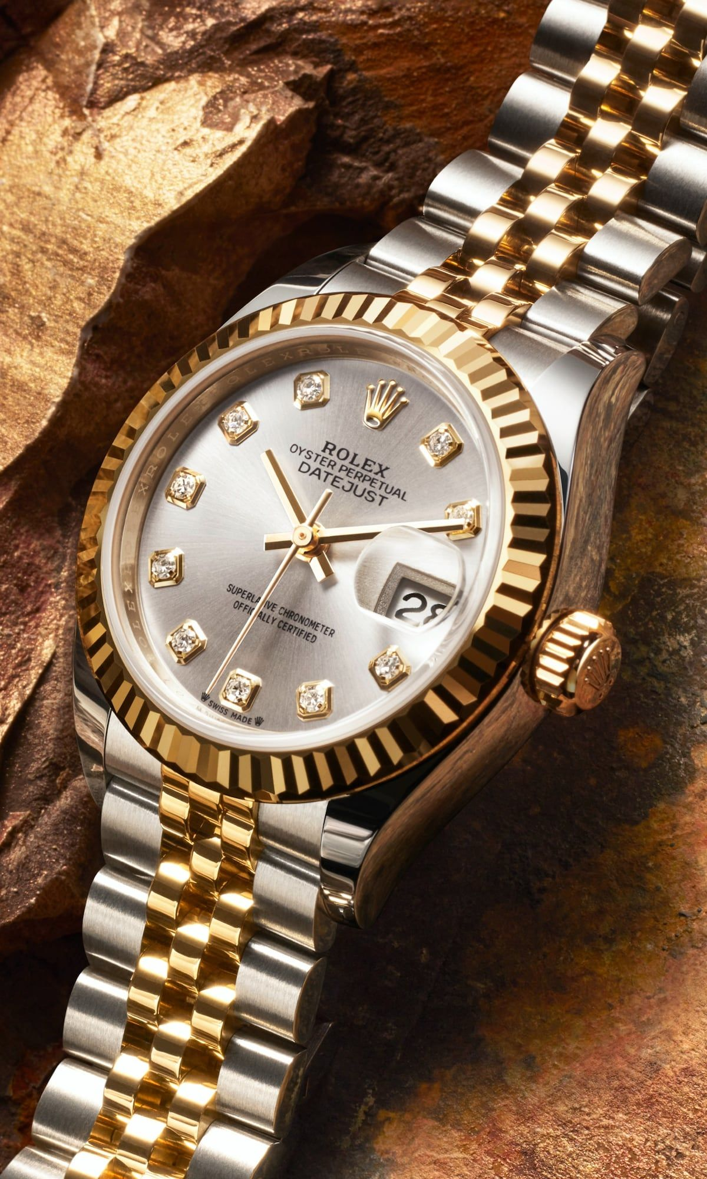

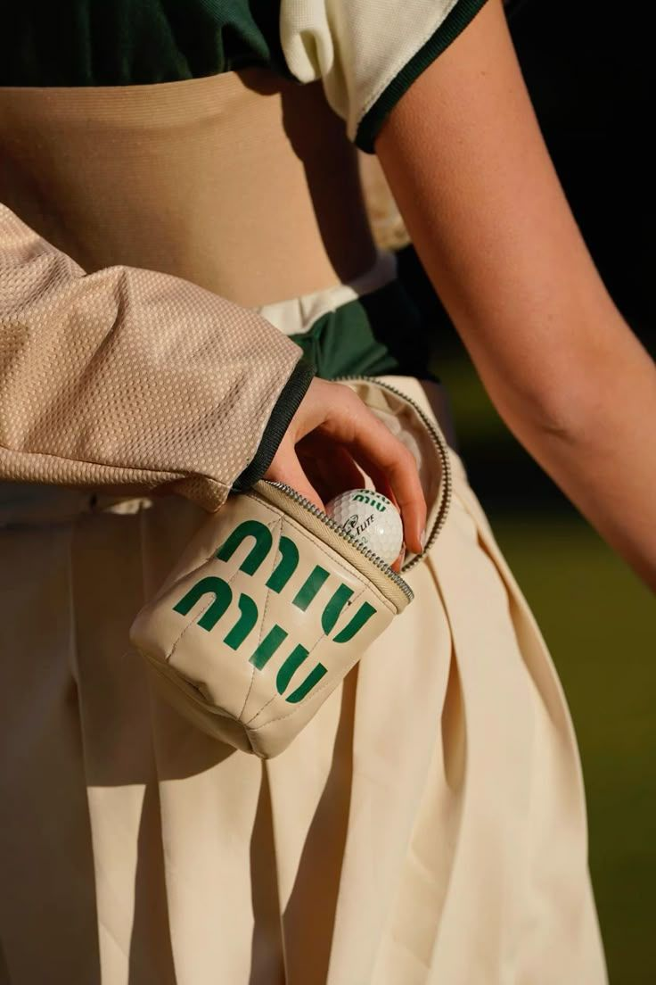
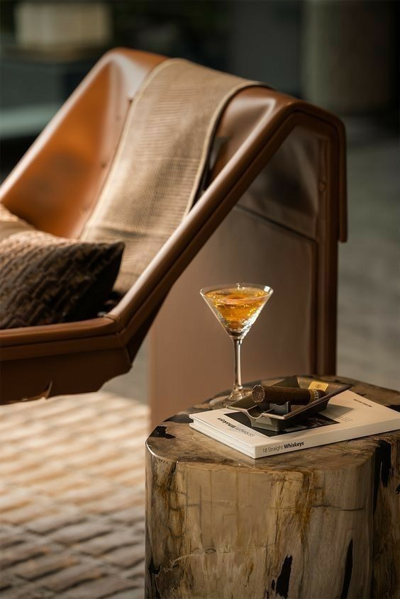
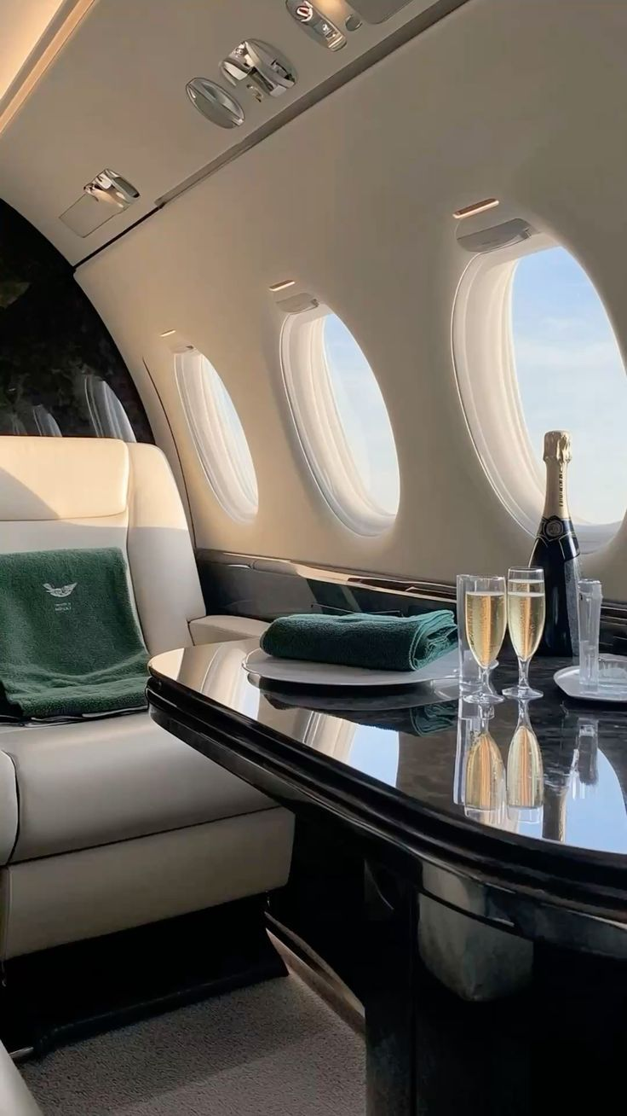
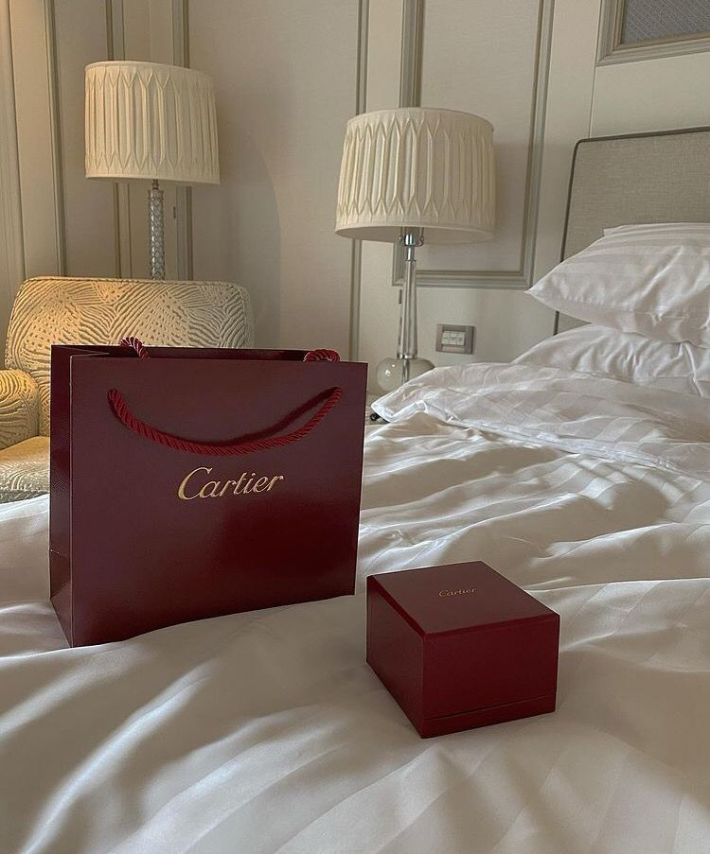
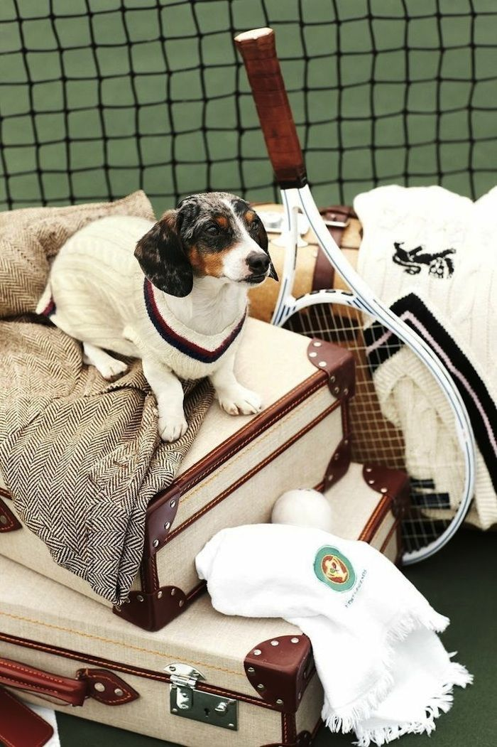
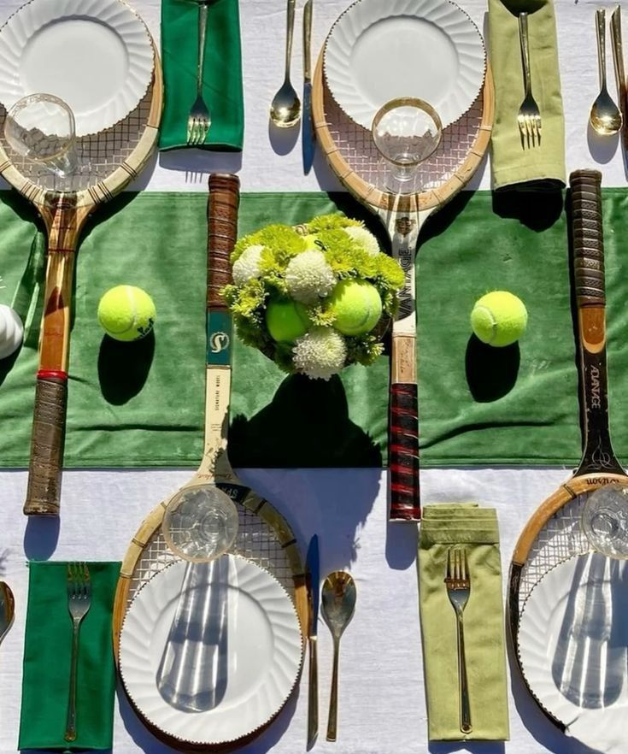
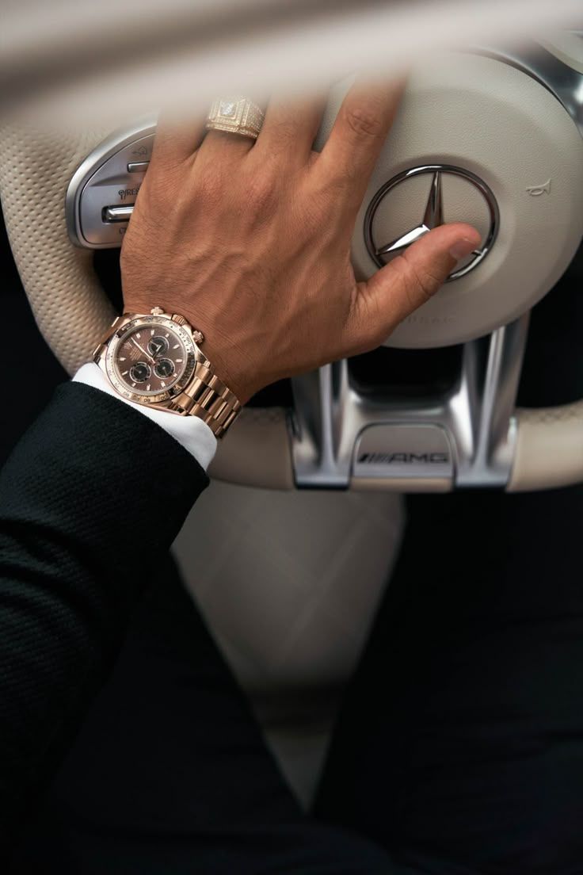
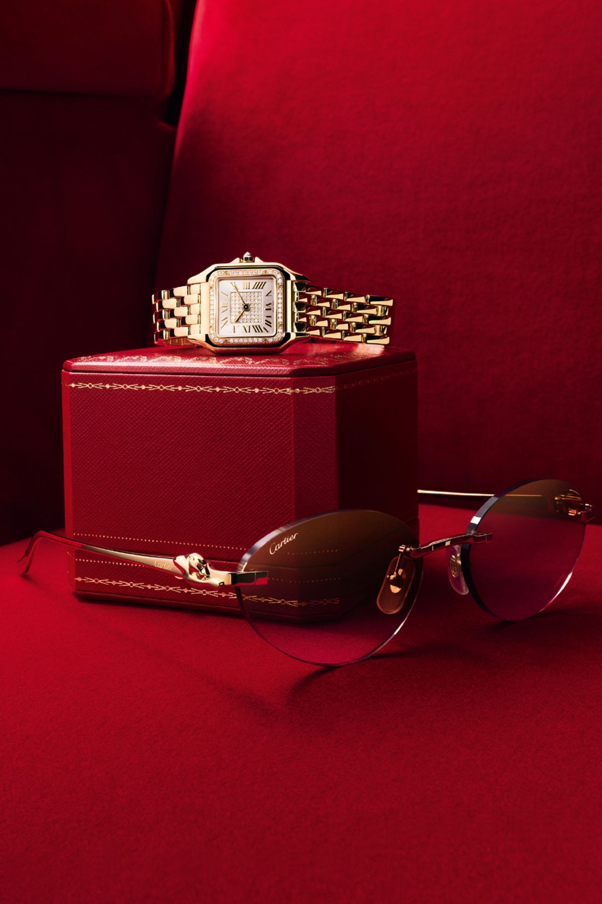
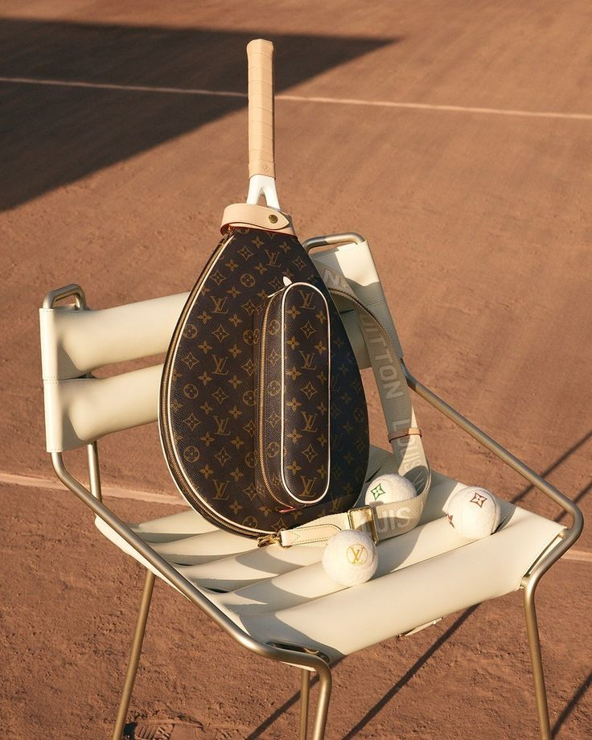
Luxury Lifestyle

Slide 21
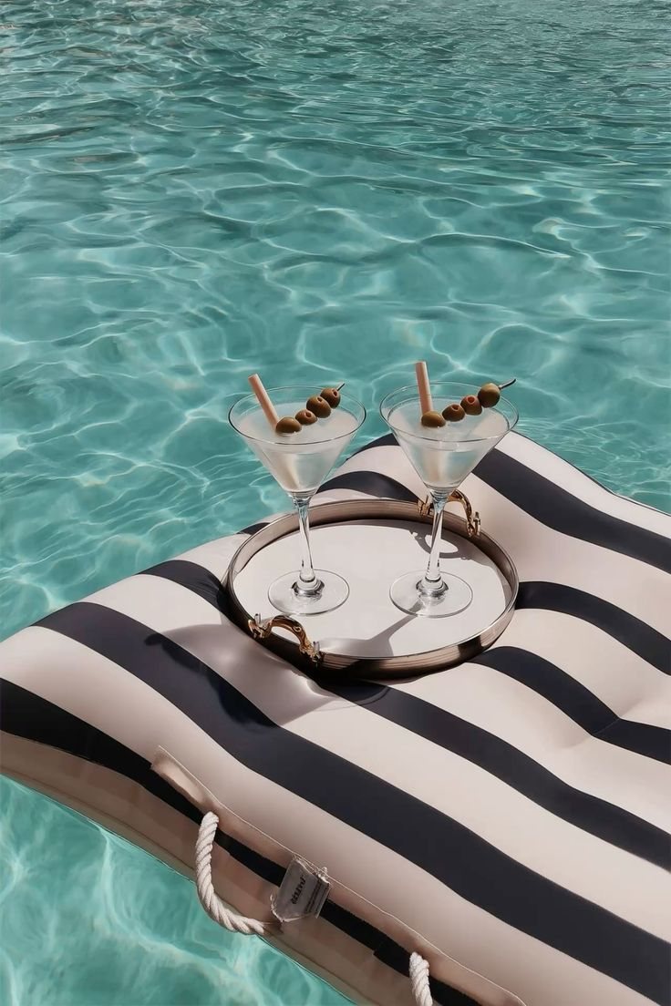
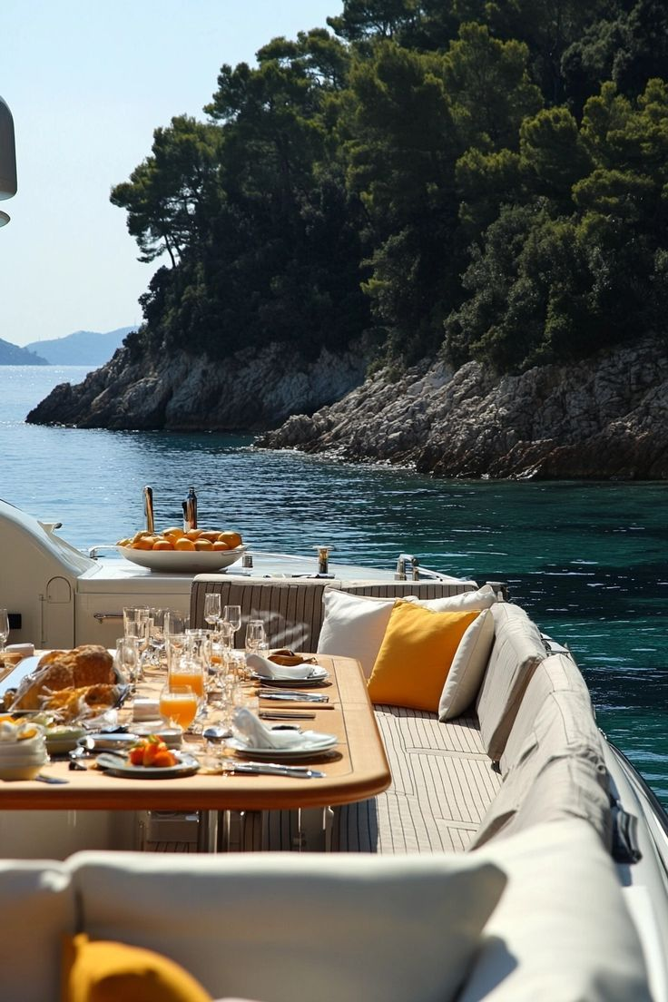
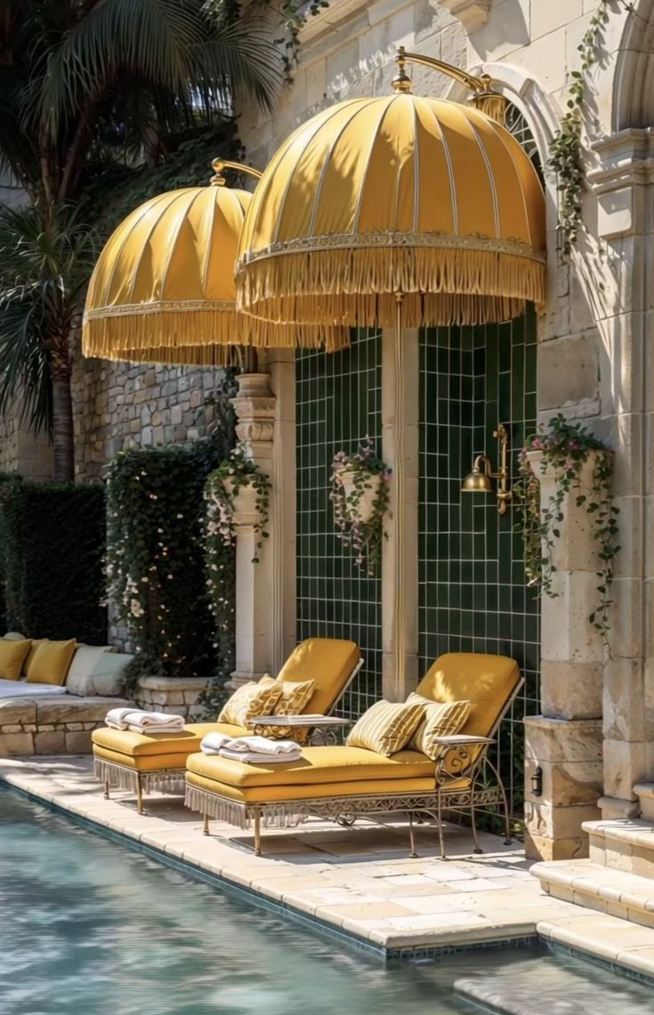
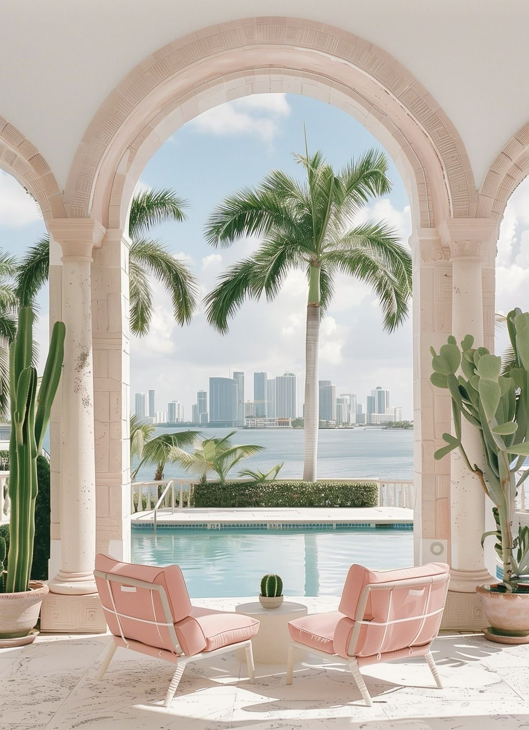
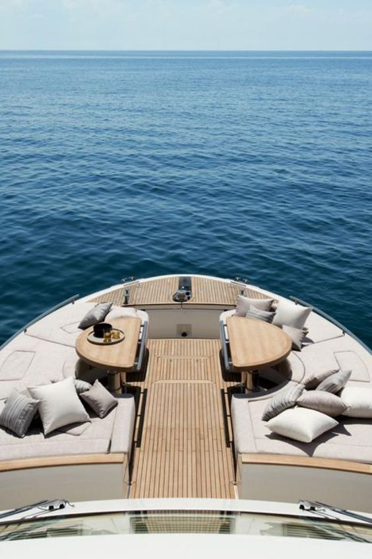
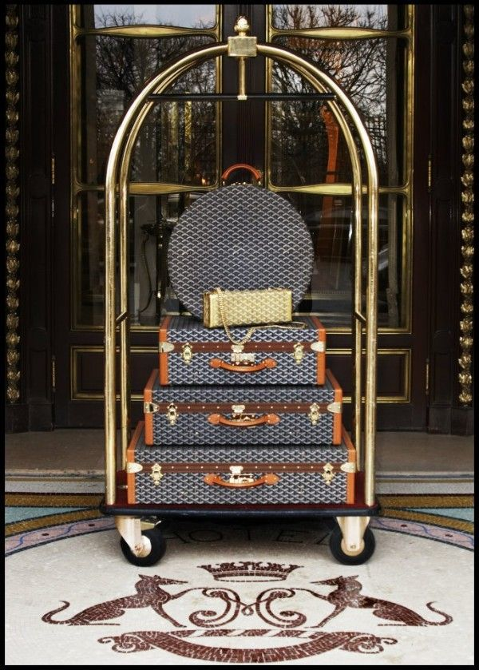

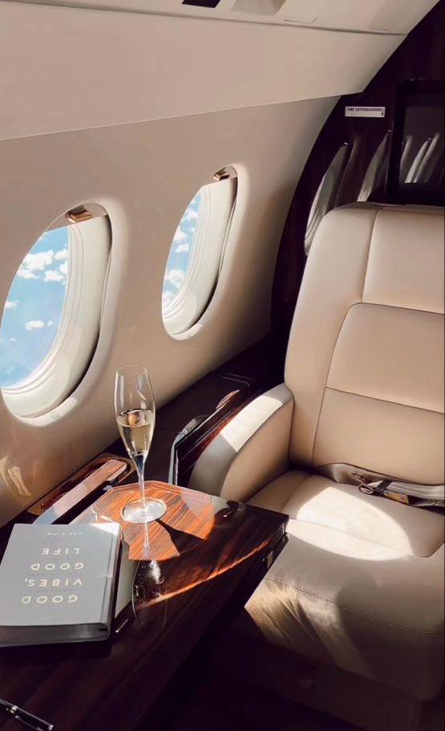
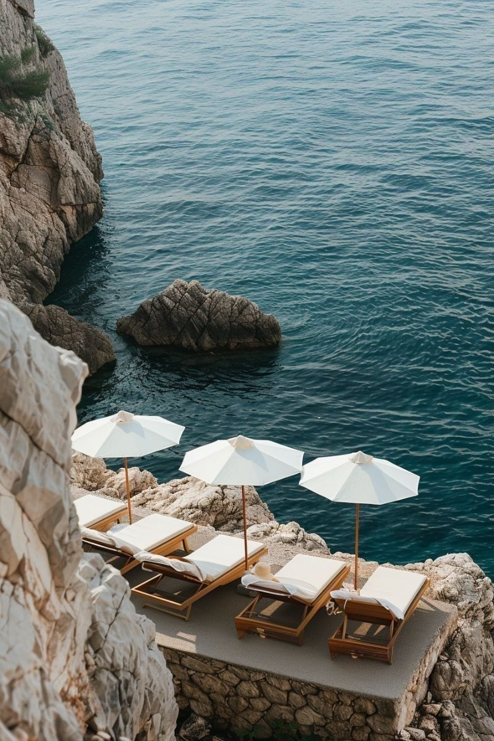
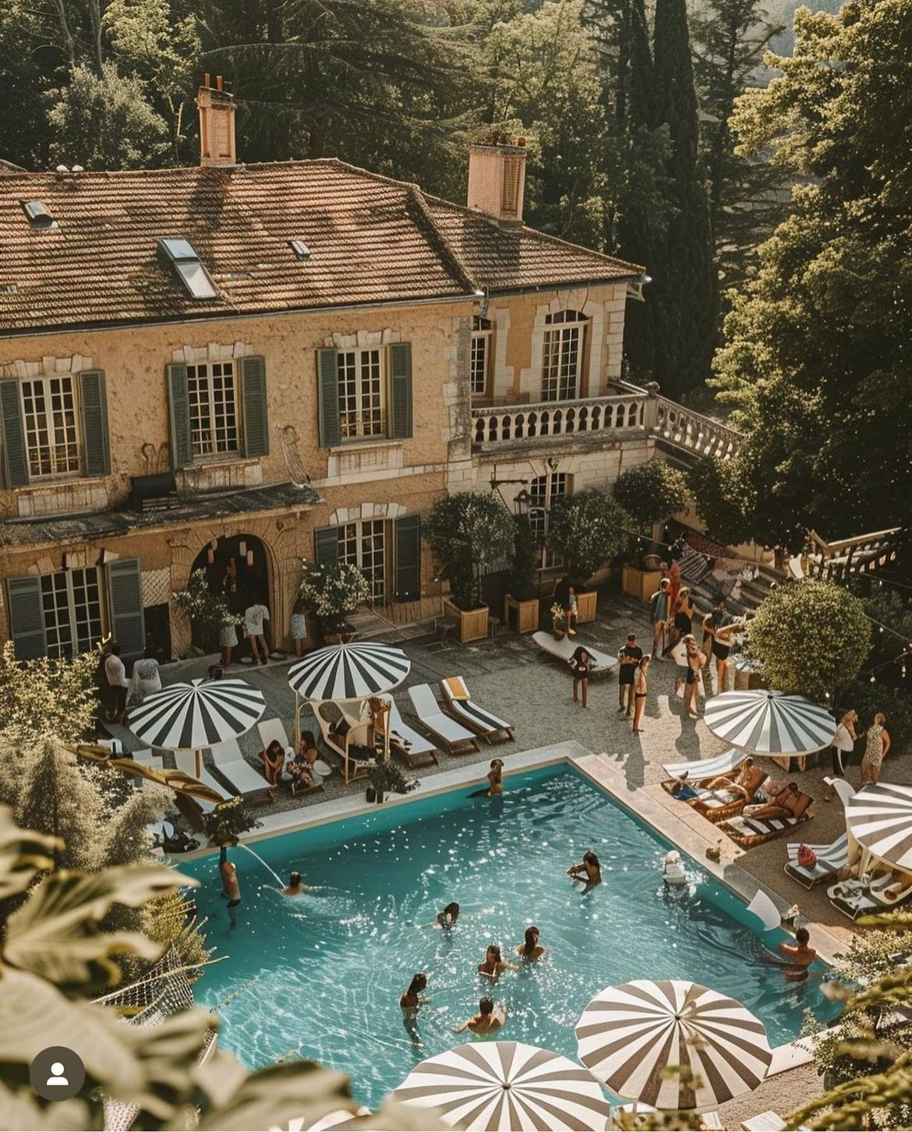

Dreaming of Jetsetting

Slide 22
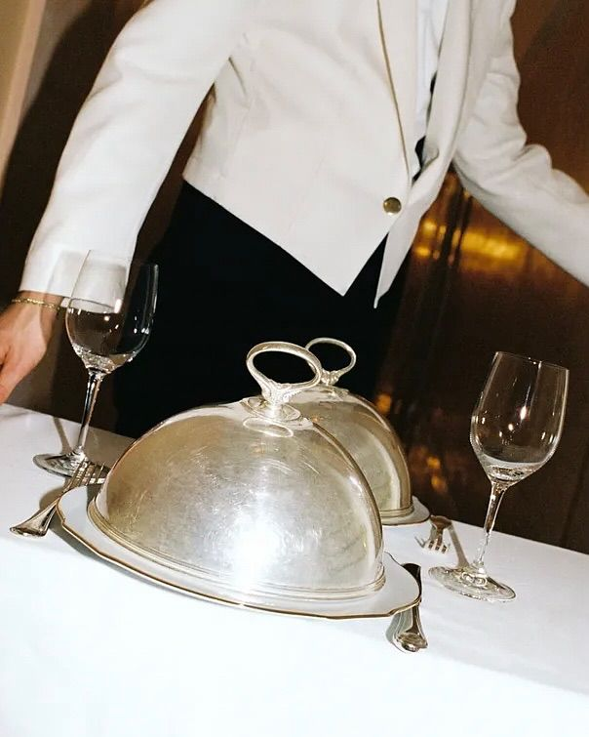
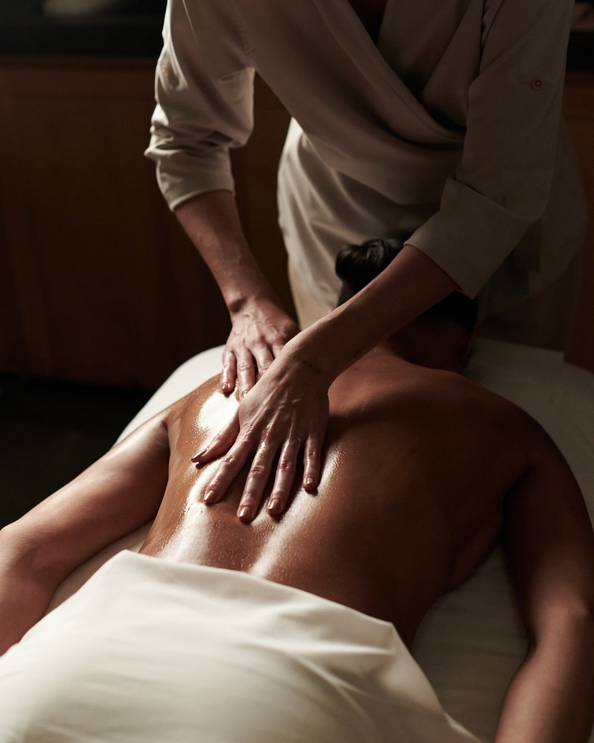
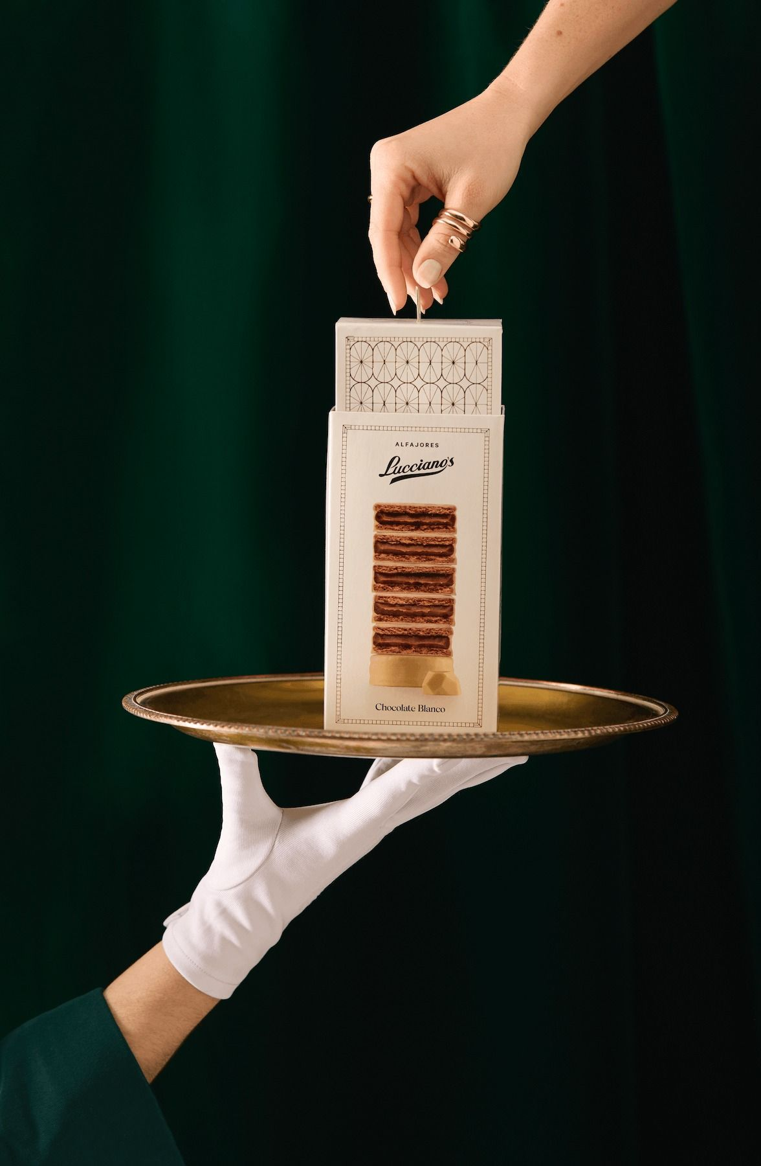
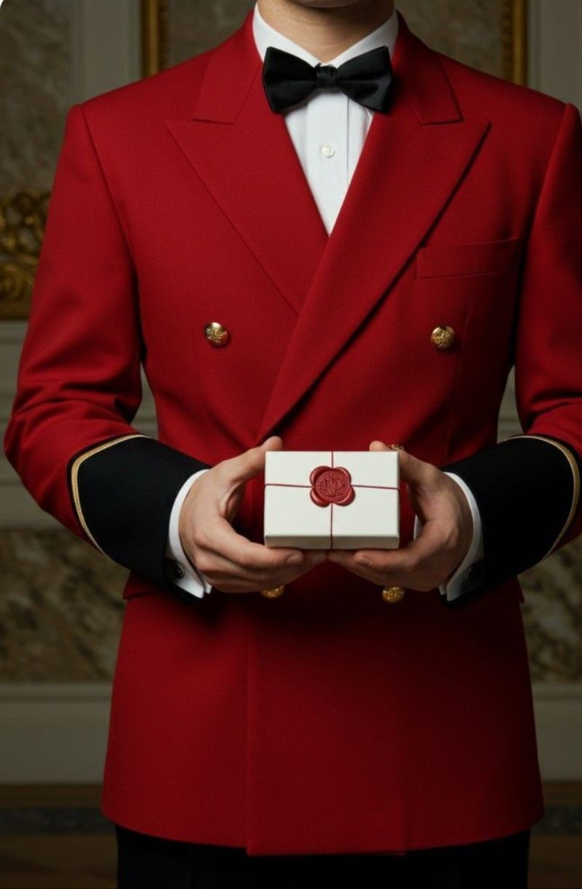
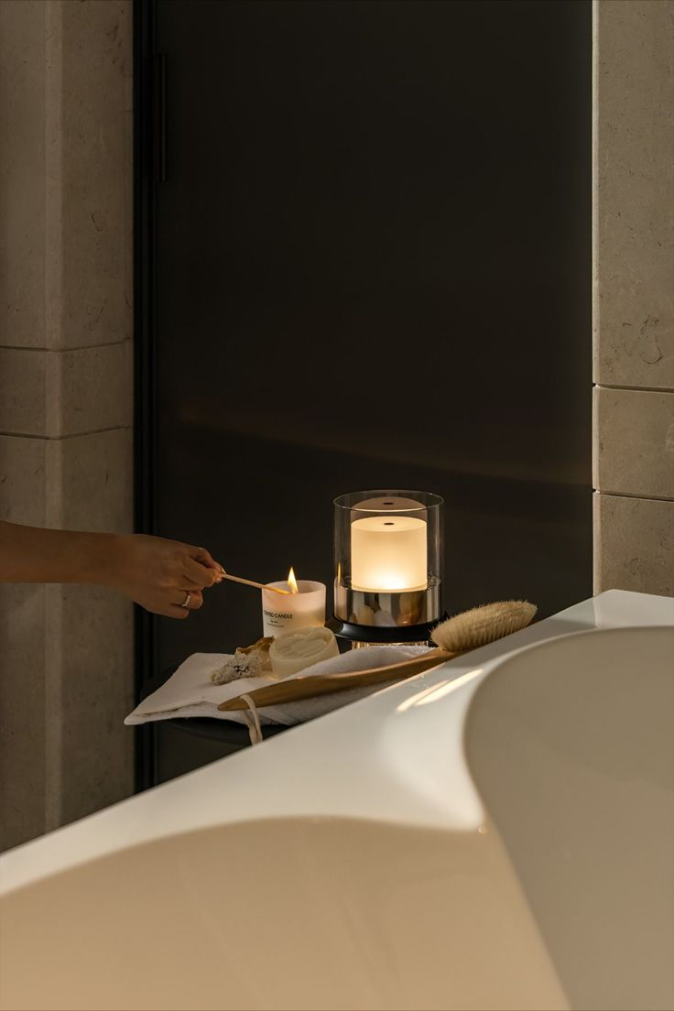
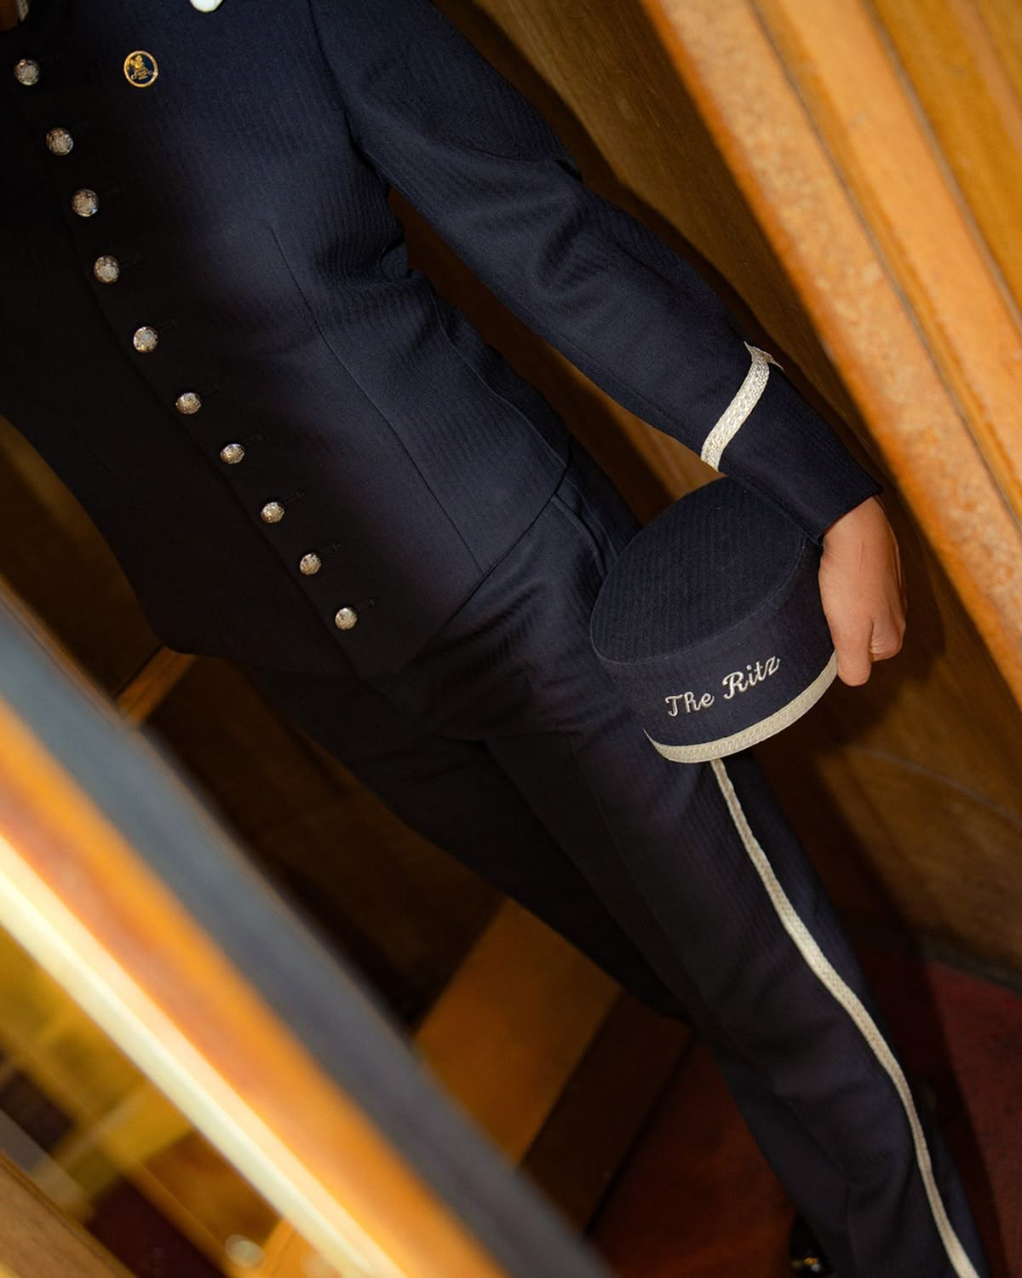
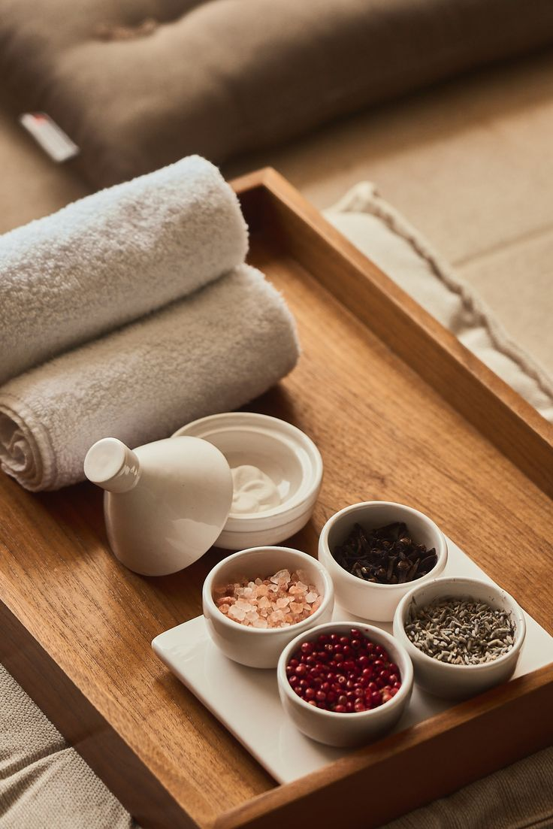

Luxury as a Service

Slide 23
Luxury is….
Pamper sessions at home.
Sunday morning lie ins.

Slide 24
Luxury is….
Having anything you need at your fingertips

Slide 25
Luxury is…
Dreaming of blue seas and white sands… while your everyday errands are taken care of.

Slide 26
Luxury is….
Planning your next vacay, while your day to day is dealt with.

Slide 27
Luxury is….
Having anything you need at your fingertips

Slide 28

Luxury is….
Knowing time is the most precious thing you own

Slide 29
______
Veyya
That straight horizontal line running across the top of the letters in Sanskrit (and related scripts like Hindi’s Devanāgarī) is called the "śirorekhā" (शिरोरेखा) — literally meaning “headline” or “headstroke.”

Slide 30
Veyya
Veyya
Veyya
Veyya
______
______
______
______
Veyya
Veyya
Veyya
Veyya
VEYYA
VEYYA
VEYYA
VEYYA

Slide 31
Veyya
Veyya
Veyya
______
______
______
Veyya
Veyya
Veyya
VEYYA
VEYYA
VEYYA

Slide 32
Veyya
Veyya
Veyya
______
______
______
Veyya
Veyya
Veyya
VEYYA
VEYYA
VEYYA

Slide 33




a)
B
C
______
Veyya
A
B
C

Slide 34
Next Steps:
Apply font, logo option and colours to slide / brand book formats to confirm chosen look and feel
Experiment with colour usage of chosen palette (primary, secondary. ascent)
Apply colour to some visual mock ups.
Design logo (TBC)
Define key words
Build put aspirational customer profile (for launch)
Visual mood board

Slide 36
Veyya represents "Empowering Everyday Living" — combining luxury comfort, simplicity, and trust within the home. It should feel warm, elegant, and modern, while standing out as aspirational yet accessible.
Brand Personality
Trait | Expression
Cozy | Soft, warm tones; gentle textures; rounded fonts
Luxury | Subtle metallics (champagne, gold, taupe); minimal aesthetic
Home | Natural materials, earthy bases (stone, beige, warm neutrals)
Simple | Clean layouts; whitespace; intuitive design
Buzz-worthy | Modern contrast element or pop color; sleek iconography; visual storytelling that photographs beautifully

